Slide 1
Google Data Analytics Capstone Project
Manoj C S
Data Analyst

Slide 2
Table of Contents
Introduction
Agenda
My Role as Data Analyst
Six Phases of Data Analysis
Ask Phase
Prepare Phase
Process Phase
Analyze Phase
Share Phase
Act Phase
Recommendations

Slide 3

Introduction
Cyclistic is a bike sharing program which features more than 5,800 bikes and 600 docking stations.
It offers reclining bikes, hand tricycles, and cargo bikes, making it more inclusive to people with disabilities and riders who can't use a standard two-wheeled bike.
It was founded in 2016 and has grown tremendously into a fleet of bicycles that are geotracked and locked into a network of 692 stations across Chicago.
The bikes can be unlocked from one station and returned to any other station in the system anytime.

Slide 4
Agenda
Design new marketing strategies to convert casual riders into annual members.
To find solutions for the following questions:
1. How do annual members and casual riders use Cyclistic bikes differently?
2. Why would casual riders buy Cyclistic annual memberships?
3. How can Cyclistic use digital media to influence casual riders to become members?

Slide 5
My Role as Data Analyst
Analyse the Cyclistic historical bike trip data to identify trends of data.
Assist the marketing analyst team in better understanding the differences between annual members and casual riders.
To find a solution for why casual riders might purchase the membership, and how digital media could affect their marketing tactics.
Create supporting visualisations and key findings to support the analysis to come up with great business solutions.
Recommendations to the company based on the analysis.

Slide 6
Six phases of Data Analysis
Ask Phase-
I asked myself questions such as
How do annual members and casual riders use Cyclistic bikes differently?
Which types of bikes were mostly preferred by the riders?
Prepare Phase-
I downloaded the dataset that is given for this case study by Coursera. I downloaded the data for the last 12 months and stored them in local folder.
Checked for issues with bias or credibility in this data.
Addressed the licensing, privacy, security and accessibility of the data.
Checked for any problems with the data.

Slide 7
Six phases of data analysis (cont.)
Process Phase-
Performed data cleaning by removing duplicates, deleting rows that had ride start time later than ride end time.
Deleted rows with NULLS in columns which were important for analysis.
Performed processing of the date column to find weekdays, which was useful to determine patterns of travel in the week.
Used Microsoft Excel for all the process and ensured data integrity throughout the data.

Slide 8
Six phases of data analysis (cont.)
Analyze Phase
In Excel, I created the ride length column to calculate the trip duration and the day of week column to populate what day of the week the ride was taken.
Pivot tables were used to help me summarise the data.
I then moved to RStudio to create data frames and merge all the separate datasets into a single dataset.
I then moved to Tableau and performed analysis of the data to find out the maximum, minimum, and average number of rides by different types of users.
Share Phase
I created data visualizations in Tableau and then combined the visualizations to create a dashboard

Slide 9
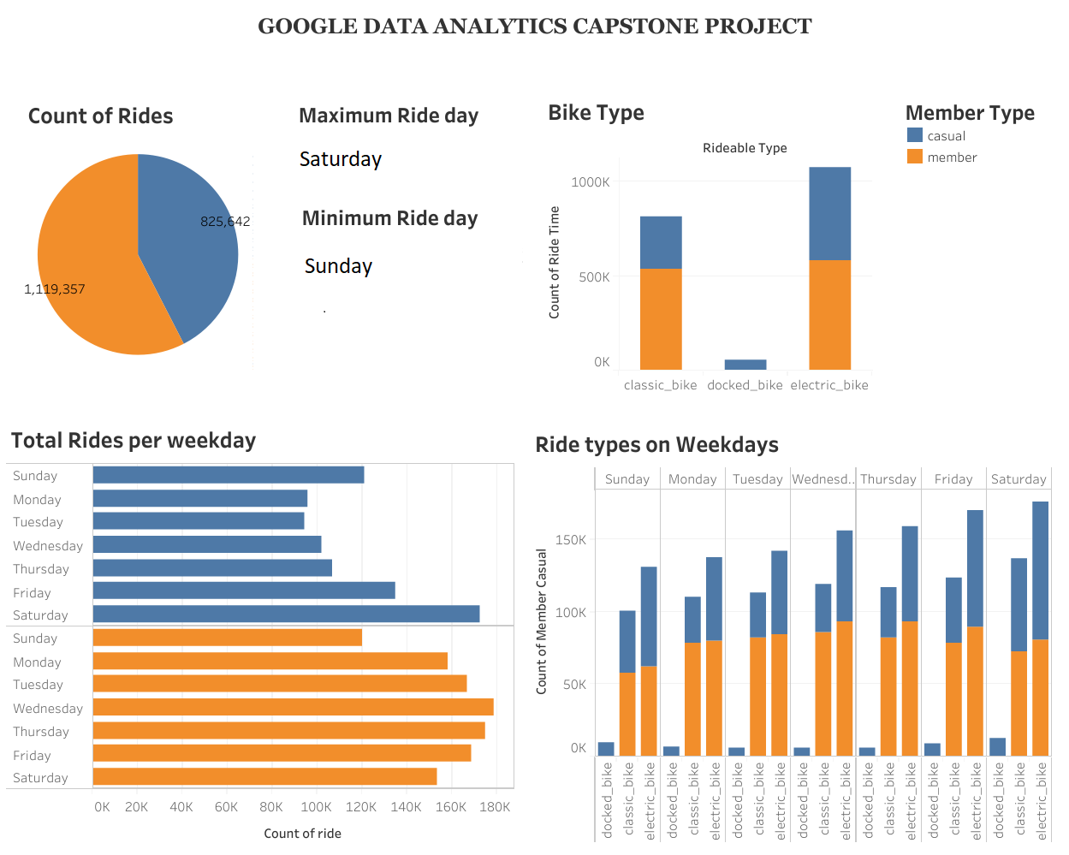

Slide 10
Act Phase
My final task was to act on key findings by providing recommendations that will help the marketing team to take informed decisions and maximize profits.
Key Findings include:
On average, casual riders take longer trips or rides than Annual Members.
This could imply that casual riders used Cyclistic bikes for leisure or other short day-to-day travel purposes.
Casual riders generally ride on weekends, whereas annual members use the membership during the week rather than on weekends.
This could imply that annual members are mostly riding their bikes to work.
Casual riders preferred using electric bikes over other ride types like classic and docked bikes.
Annual members preferred classic bikes over other varieties.
In terms of ride time, electric bikes were the most preferred by both casual and annual members for longer rides.

Slide 11
Recommendations
Users who take long rides shall be given a discount on bike rentals, or better yet, annual members who travel more than a specific distance, say 10 miles, should be given a discount.
Cyclistic bike-share should offer a weekend-only membership that is less expensive than the current seven-day membership.
A rewards programme in the form of discounts to annual Members who use a specific ride type or more shall be implemented.

Slide 12

Thank you

